Slide 1
Four Corners
First Day of School

Slide 2




Favorite Color

Slide 3
Find someone you don’t know and introduce yourselves.
Tell your new partner something fun you did over summer.

Slide 4



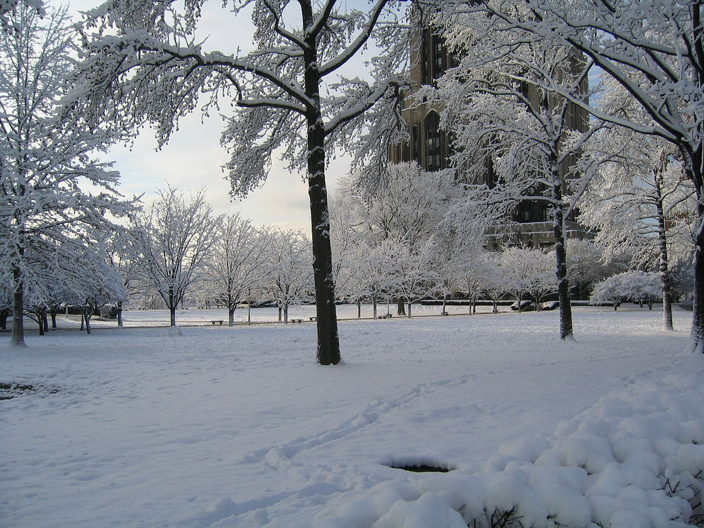
Favorite Season

Slide 5
Find someone you don’t know and introduce yourselves.
Tell your partner about your favorite tv show or movie.

Slide 6





Slide 7
Find someone you don’t know and introduce yourselves.
Tell your new partner about your sibling(s), or about your parents if you are an only child.

Slide 8



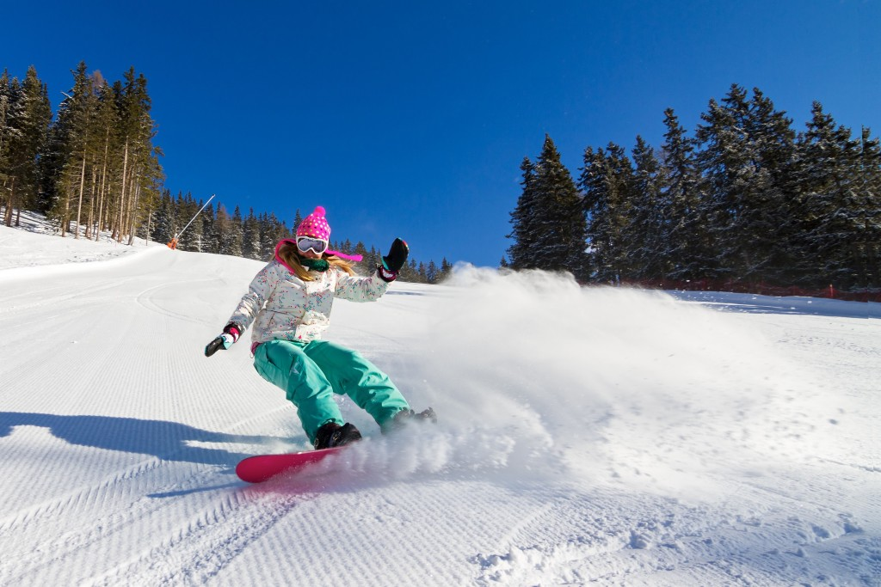
Favorite Vacation Destination

Slide 9
Find someone you don’t know and introduce yourselves.
Tell your new partner the best vacation you have ever been on.

Slide 10




Favorite School Subject

Slide 11
Find someone you don’t know and introduce yourselves.
Tell your new partner your favorite type of food and specific meal.

